Slide 1
TAP Game Development Workshop
Red Godana, Ronoquade Lawrence, Sean Nolan

Slide 2
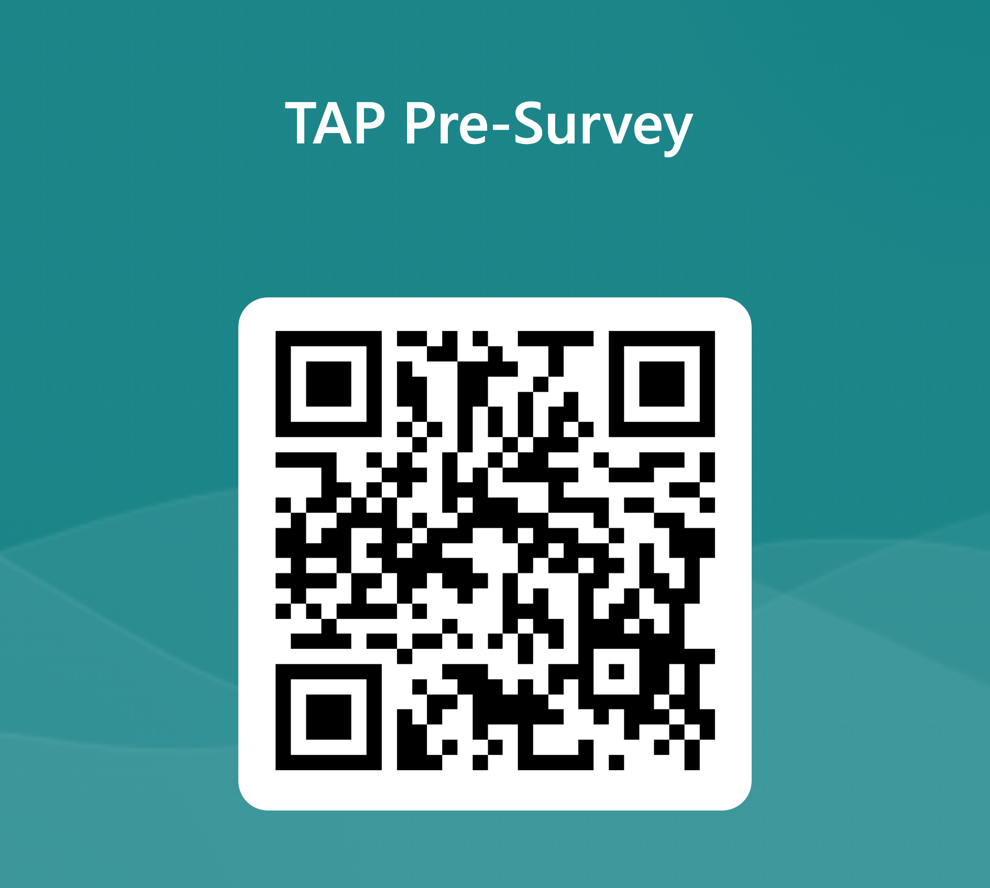
Pre-Survey
Scan the QR code to access the survey or go to:
https://shorturl.at/qCNTW

Slide 3

Technology Ambassador Program (TAP)
TAP is a service-learning initiative that empowers IT students to collaborate on technology projects with other students and mentors, and participate in workshops, conferences, and other community outreach events
TAP aims to enhance technical and professional skills while fostering an interest in IT

Slide 4

Workshop Objectives & Goals
We are aiming to engage students in developing an interest in IT and game development
We will be using a fun hands-on activity designed to provide participants with practical game development experience

Slide 5

Project Description
Participants will progress through a pre-built obstacle course in the game engine Roblox Studio, which is a game engine used to make Roblox games
Each obstacle will teach a new basic skill such as 3D model manipulation and basic scripting in the Lua scripting language
The obstacle course aims to teach basic game development skills to engage students and foster an interest in game development and IT

Slide 6
Data
Participants will progress through a pre-built obstacle course in the game engine Roblox Studio, which is a game engine used to make Roblox games
Each obstacle will teach a new basic skill such as 3D model manipulation and basic scripting in the Lua scripting language
The obstacle course aims to teach basic game development skills to engage students and foster an interest in game development and IT

Slide 7
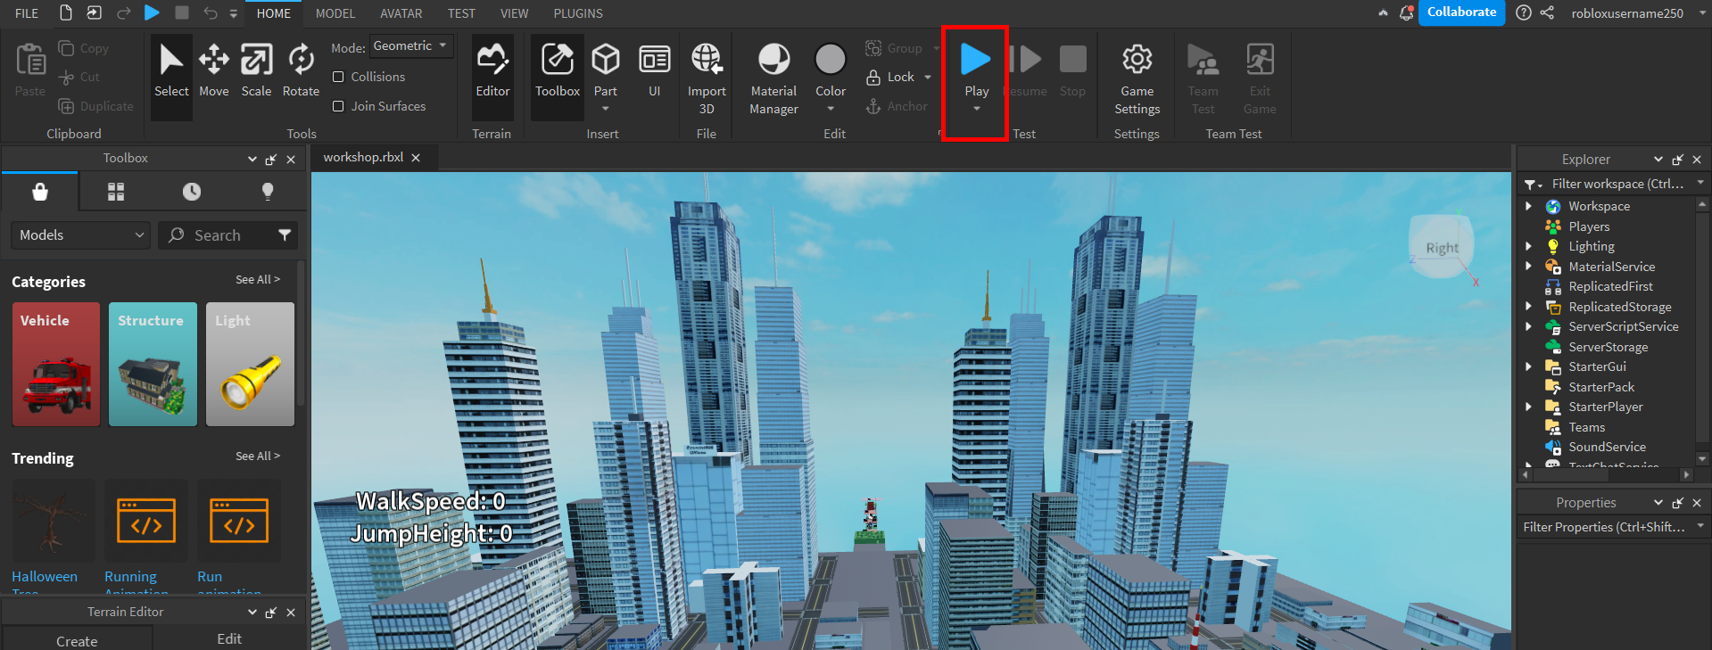
3. Download and open the Roblox Studio (.rblx) file sent to your email
4. Click the blue Play button at the top of the screen
5. Using the WASD keys to move around and the right mouse button to rotate your camera, follow along with the signs in game

Slide 8
Workshop Methods
Login or create an account
Download the Roblox Studio (.rblx) file
Right click the Roblox Studio (.rblx) file and open with Roblox Studio
Click the blue Play button at the top of the screen
Using the WASD keys to move around and the right mouse button to rotate your camera, follow along with the signs in game

Slide 9
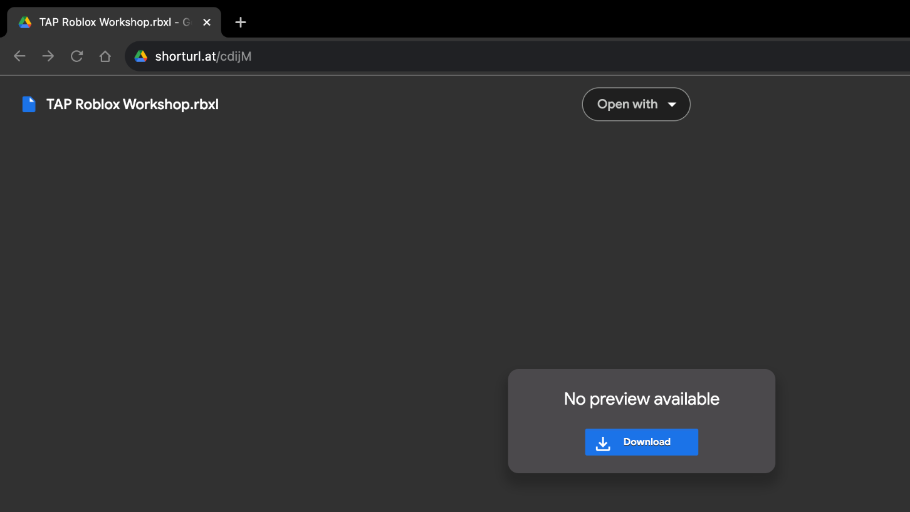
shorturl.at/cdijM

Slide 10
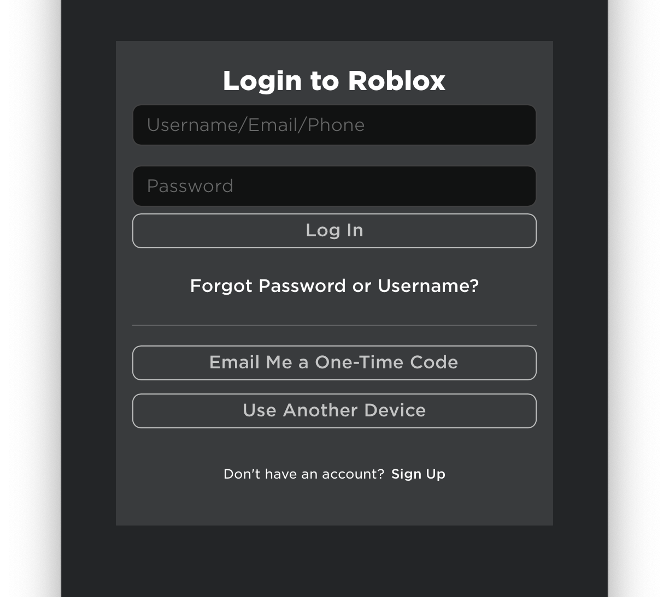
Login or create an account

Slide 11
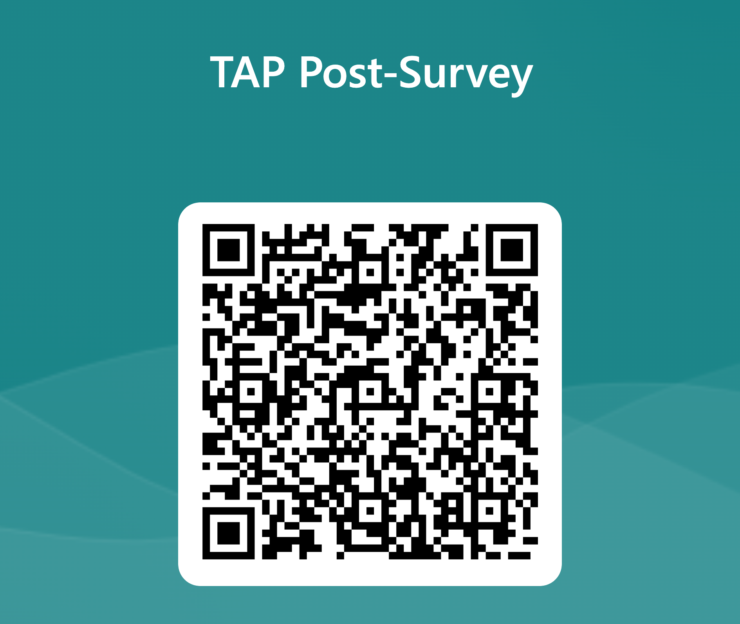
Post-Survey
Scan the QR code to access the survey or go to:
https://shorturl.at/lNS02

